Slide 1
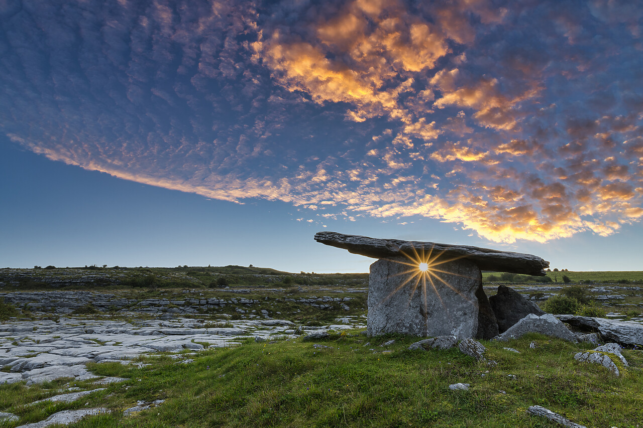



8,000 BC to AD 400
Chapter 3
ANCIENT IRELAND
ancient ireland
Strand Two: The History of Ireland
@MsDoorley

Slide 2
Learning Outcomes
2.1 RECOGNISE how a pattern of settlement and plantation influenced identity on the island of Ireland, referring to one example of a pattern of settlement, such as the growth of towns, and one plantation
1.5 INVESTIGATE the job of the historian, including how s/he finds and uses evidence to form historical judgements which may be revised and reinterpreted in the light of new evidence
1.6 DEBATE the usefulness and limitations of different types of primary and secondary sources of historical evidence, such as written, visual, aural, oral and tactile evidence; and APPRECIATE the contribution of archaeology and new technology to historical enquiry
Strand Two: The History of Ireland
Chapter Three: Ancient Ireland
@MsDoorley

Slide 3
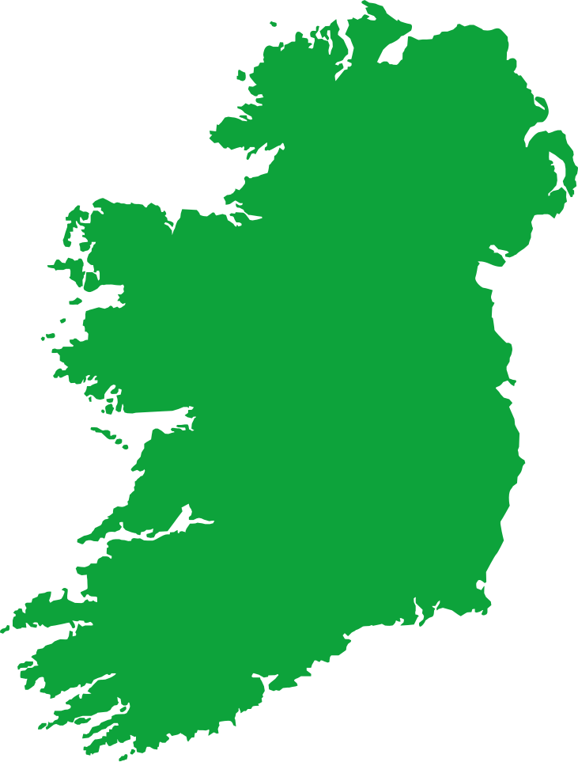
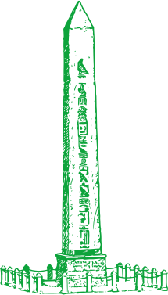

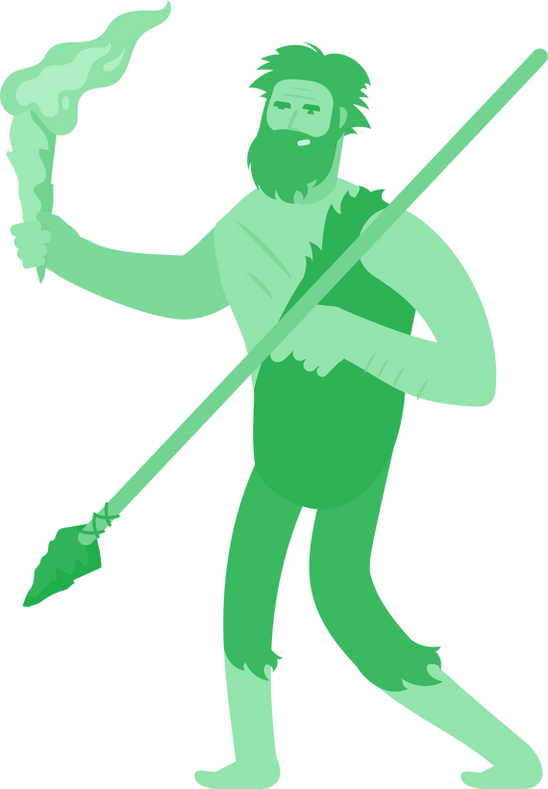


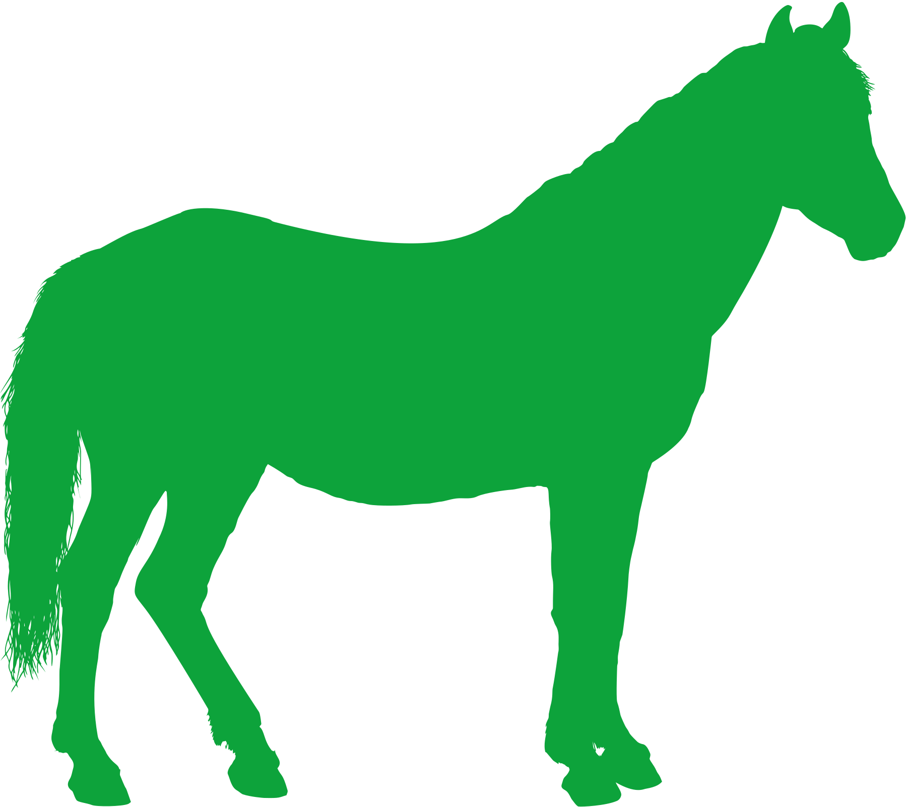

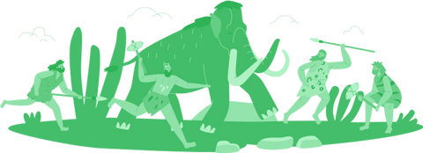
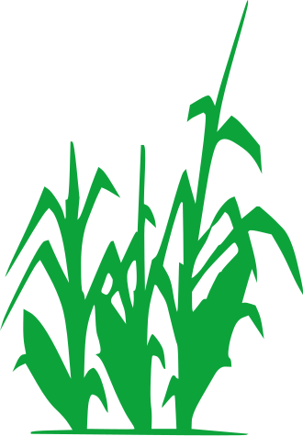


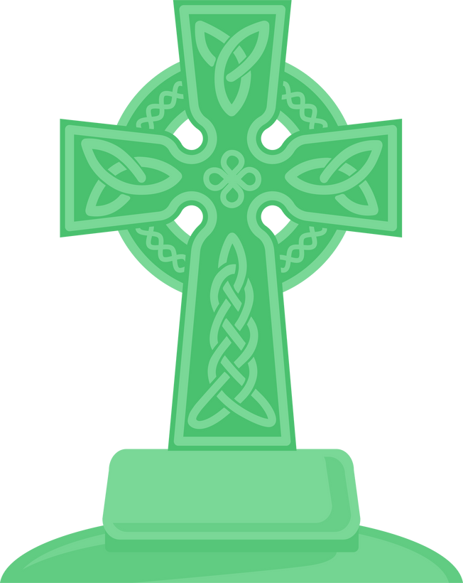
Chapter 3
ANCIENT IRELAND
2.1 RECOGNISE how a pattern of settlement and plantation influenced identity on the island of Ireland, referring to one example of a pattern of settlement, such as the growth of towns, and one plantation
The Middle Stone Age
(Mesolithic)
The first people in Ireland
Newgrange is constructed in the Boyne Valley, Co. Meath.
The Iron Age
Iron replaced Bronze
The arrival of the Celts to Ireland
Strand Two: The History of Ireland
Chapter Three: Ancient Ireland
30,000 BC
8,000 BC
3,500 BC
3,200 BC
2,300 BC
500 BC
AD 400
@MsDoorley
The Old Stone Age
(Paleolithic)
No evidence of people living in Ireland
The New Stone Age
(Neolithic)
The first farmers in Ireland
The Bronze Age
The first recorded use of metal in Ireland
The arrival of Christianity to Ireland

Slide 4
Introduction
In this chapter, we will journey through Ancient Ireland, a fascinating period that extends from the Stone Age through the Bronze Age, up until the Iron Age. This was a time when pioneers first set foot on the island, gradually transforming the untouched land into thriving settlements, forging the backbone of what would eventually become our Irish community. Amidst an era shrouded in the mists of prehistory - a time before the advent of writing - the only torch lighting our path into this captivating past is the rich trove of archaeological evidence.
Progressing through the different Ages of Ancient Ireland, we will transition into the Iron Age, a pivotal period marked by the arrival of the Celts. With their intricate societal structures, advanced ironworking techniques, and rudimentary form of writing, the Celts wielded significant influence, introducing a new chapter in Ireland's expansive historical narrative.
Strand Two: The History of Ireland
Chapter Three: Ancient Ireland
@MsDoorley

Slide 5
8,000 BC to 3,500 BC
Chapter 3
3.1: MESOLITHIC IRELAND
3.1: mesolithic ireland
Strand Two: The History of Ireland
@MsDoorley

Slide 6
The first settlers in Ireland
  The Stone Age is split into three periods:
    Palaeolithic – Early – 2,500,000 BC to 8,000 BC
    Mesolithic – Middle – 8,000 BC to 3,500 BC
    Neolithic – New – 3,500 BC to 2,000 BC
  This period of history is known as the Stone Age because all tools and weapons were made from stone.
  The first people arrived in Ireland during the Mesolithic Period.
  It's likely that they arrived from Scotland in dugout canoes. They were a nomadic people: they moved from place to place.
  They lived in small basket-like huts that were made from branches and covered with grass and animal hides.
  They were hunter-gatherers; they hunted animals such as wild boars and birds, fished and gathered fruit, nuts and berries.
  The oldest known Irish mesolithic site is in Mount Sandel in Co. Derry.
Strand Two: The History of Ireland
Chapter Three: Ancient Ireland
@MsDoorley

Slide 7
Mesolithic Burial Customs
  A burial site in Hermitage, Co. Limerick tells us that the Mesolithic people cremated (burned) the bodies of the dead and buried them with axes and other valuable items (grave goods).
    They may have cremated their dead to stop animals from going after the decomposing bodies.
  These are very important for archaeologists as the objects are well preserved.
  It also suggests that the people believed in some form of afterlife.
Strand Two: The History of Ireland
Chapter Three: Ancient Ireland
@MsDoorley

Slide 8
Checkpoint pg. 28 (Artefact, 1st Edition)
  Why is this period called the Stone Age?
  Explain the terms: hunter-gatherer; nomadic; grave goods.
  What weapons and tools did they use? What were these made from?
  Describe a Mesolithic house.
  Why might archaeologists think that the Mesolithic people believed in an afterlife?
Strand Two: The History of Ireland
Chapter Three: Ancient Ireland
@MsDoorley

Slide 9
3,500 BC to 2,300 BC
Chapter 3
3.2: NEOLITHIC IRELAND
3.2: neolithic ireland
Strand Two: The History of Ireland
@MsDoorley

Slide 10
The First Farmers
  Between 4,000 and 3,500 BC, new settlers arrived in Ireland. The brought new skills such as: farming, bread-making, tomb-building and pottery-making.
  The most important of these new skills was the introduction of farming.
  Unlike the mesolithic people, the neolithic people settled and built communities by cutting down trees and clearing land to plant crops. They also kept animals.
  There are several major Neolithic sites in Ireland, some of which are:
    The Céide Fields, Co. Mayo.
    Lough Gur, Co. Limerick.
    The Boyne Valley, Co. Meath.
  Like the Mesolithic people, they hunted and gathered but it was no longer their main source of food. Their tools and weapons were still made from stone.
  They ploughed land with mattocks and ploughs, grew crops like wheat and barley, domesticated animals like sheep and pigs, made bread using a saddle stone and made the first pots using local cay (used to store food, tools or ashes of the dead).
Strand Two: The History of Ireland
Chapter Three: Ancient Ireland
@MsDoorley

Slide 11
Neolithic Burial Customs
  A significant change in Neolithic Ireland was a new emphasis on building tombs for cremated remains and grave goods.
  There were three main types of megalithic (huge stone) tombs:
    Passage graves – these were huge mounds built over a central passage which led to a chamber for the dead. (Newgrange, Co. Meath)
    Court cairns – these had an open space (court) at the front and a chamber originally covered by a mound of stones (cairn) for the dead behind. (Creevykeel, Co. Sligo)
    Portal dolmens – Two or more standing stones and a huge capstone resting across the top with the remains placed inside. (Poulnabrone dolmen, the Burren, Co. Clare)
  The megaliths for these tombs would have been floated along rivers on rafts or rolled for miles on logs. Building these tombs would have taken hundreds of people and also clearly showcases that the Neolithic people clearly had knowledge of the stars and were skilled engineers.
Strand Two: The History of Ireland
Chapter Three: Ancient Ireland
@MsDoorley

Slide 12
Checkpoint pg. 30 (Artefact, 1st Edition)
  What important change took place in Ireland during the Neolithic Period?
  What foods were produced by Neolithic farmers?
  Describe Neolithic houses and how these were different from Mesolithic houses.
  Describe (a) a passage tomb; (b) a court cairn; (c) a portal dolmen.
  Explain the following terms: wattle and daub; megaliths.
Strand Two: The History of Ireland
Chapter Three: Ancient Ireland
@MsDoorley

Slide 13
Checkpoint pg. 30 (Artefact, 1st Edition)
  Farming was introduced.
  Crops such as wheat and barley and meat from domesticated animals such as sheep and pigs.
  Neolithic houses had poles driven into the ground (post holes) and walls of wattle and daub. The roof was thatched with straw or rushes. They were much bigger and more permanent than the houses of the Mesolithic people.
    Passage tomb: huge mounds built over a central passage which led to a chamber for the dead.
    Court cairn: an open space (court) at the front and a chamber originally covered by a mound of stones (cairn) for the dead behind.
    Portal dolmen: Two or more standing stones and a huge capstone resting across the top with the remains placed inside.
  Wattle and daub: wooden sticks woven together like a basket (wattle) and covered with a mud paste (daub). Megaliths: large stones
Strand Two: The History of Ireland
Chapter Three: Ancient Ireland
@MsDoorley

Slide 14
2,300 BC to 500 BC
Chapter 3
3.3: BRONZE AGE IRELAND
3.3: Bronze Age Ireland
Strand Two: The History of Ireland
@MsDoorley

Slide 15
Metal comes to Ireland
  Archaeologists believe the first use of metal in Ireland was around 2,000 BC; this was the Bronze Age.
  Bronze (an alloy (combination) of copper and tin) was stronger than stone but was also much easier to shape so people had greater control over the tools and weapons they could make.
  Copper was mined at Mount Gabriel in Co. Cork but tin had to be imported from the likes of Cornwall in Britain.
  Bronze was made by the process of smelting copper and tin – melting metal at a high temperature to separate it from the ore – combining them and pouring them into moulds to set.
  Metalworkers (smiths) made tools such as sickles (to cut crops), axes and ploughs and weapons such as knives, swords, shields and spears while farming remained the main source of food for Bronze Age people.
Strand Two: The History of Ireland
Chapter Three: Ancient Ireland
@MsDoorley

Slide 16
Life in the Bronze Age
  They grew wheat and barley; kept animals such as pigs, sheep and cattle; and hunted animals such as birds and fish.
  As skills developed, smiths made bronze pots and cauldrons for cooking, horns for music and jewellery in gold and bronze like bracelets, armlets, earrings, necklaces, torcs and lunulae.
  Querns were used to grind corn into flour for bread.
  Meat was cooked in a fulacht fiadh.
    This was a stone-lined pit which was filled with water.
    Stones were then heated in a fire and lowered into the water to make it boil.
    The meat was wrapped in straw and left boiling until ready to eat.
  While most houses in the Bronze Age were very similar to Neolithic houses (wattle and daub walls, thatched roofs), there were a couple of changes.
    Firstly, they were bigger (about 6 metres wide) and circular.
    Secondly, houses and other smaller buildings were enclosed behind timber fences, earth embankments and ditches to defend the people from attacks and/or keep their animals safe at night.
Strand Two: The History of Ireland
Chapter Three: Ancient Ireland
@MsDoorley

Slide 17
Bronze Age Housing
Rath
Crannóg
  A rath was an earthen fort made by digging out a circular trench and piling up the earth in the centre.
  The houses were built on the rath so they could see enemies approach.
  Houses were made of wattle and daub, timber or stone, depending on available materials locally.
  Roofs were mostly thatched with reeds or straw.
  Animals were kept in the rath at night or when under attack.
  A gateway was the only way in.
  A kind of fort built on the middle of a lake.
  Wooden posts were sunk into the lake. The centre was filled with stones, branches and earth until the base reached the surface of the water.
  A wooden fence surrounded the crannóg.
  Hidden stepping stones or dug out canoes were used to get out to the crannóg.
  Some had a drawbridge which could be pulled in when under attack.
Strand Two: The History of Ireland
Chapter Three: Ancient Ireland
@MsDoorley

Slide 18
Bronze Age Burial Customs
  Some Bronze age burials were similar to those of Neolithic period.
  Wedge tombs were smaller versions of portal dolmens.
  As the population of the island grew during the Bronze Age, cist graves became more common.
    These were less difficult to build; just stone-lined graves in the ground.
    The body was buried in a crouched or foetal position with grave goods.
Strand Two: The History of Ireland
Chapter Three: Ancient Ireland
@MsDoorley

Slide 19
Checkpoint pg. 32 (Artefact, 1st Edition)
  Which two metals were used to make bronze?
  Why was the use of metal important?
  What was a fulacht fiadh and how was it used?
  What types of jewellery were made in the Bronze Age?
  How were houses in the Bronze Age (a) similar to and (b) different from those of the Neolithic period?
  Describe a cist grave.
Strand Two: The History of Ireland
Chapter Three: Ancient Ireland
@MsDoorley

Slide 20
Checkpoint pg. 32 (Artefact, 1st Edition)
  Copper and tin are the two metals used to make bronze.
  Metal was stronger than stone but easier to shape and mould to create tools and weapons.
  A fulacht fiadh was a pit which was lined with stones and filled with water. Stones were then heated in a fire and lowered into water to make it boil. The meat was wrapped in straw and left boiling until ready to eat.
  Jewellery was made in gold and bronze, for example bracelets, armlets, earrings, necklaces, torcs and lunulae.
  Similarities between Bronze Age and Neolithic housing: wattle and daub walls, thatched roofs. Differences: Neolithic houses were much bigger and circular, enclosed behind wooden fences and earthen banks
  A cist grave was a stone-lined grave in which the body was buried in a crouched or foetal position with its grave goods
Strand Two: The History of Ireland
Chapter Three: Ancient Ireland
@MsDoorley

Slide 21
500 BC to AD 400
Chapter 3
3.4: IRON AGE IRELAND
3.4: Iron Age Ireland
Strand Two: The History of Ireland
@MsDoorley

Slide 22
The arrival of the Celts
  Believed to have migrated from Central Europe, specifically areas corresponding to present-day Austria and Switzerland, the Celts settled in Ireland between 500-300 BC. Along with them, they transported their vibrant culture, language, and religious practices, as well as horses and iron-working skills. Iron, being a far superior material to bronze, swiftly supplanted the latter as the principal metal for fabricating tools and weapons. Simultaneously, Celtic culture burgeoned, establishing its dominance over the course of the ensuing millennium.
  The Celts were notable for introducing a highly organised society in Ireland, a precedent in the region. Ireland was partitioned into numerous tuaths (kingdoms), each presided over by a rí or (king). Immediately beneath the king were the aos dána – a group comprised of warriors, nobles, and individuals possessing special skills. Following them were the farmers and ordinary citizens, while the labourers and slaves formed the society's lowest class.
Strand Two: The History of Ireland
Chapter Three: Ancient Ireland
@MsDoorley

Slide 23
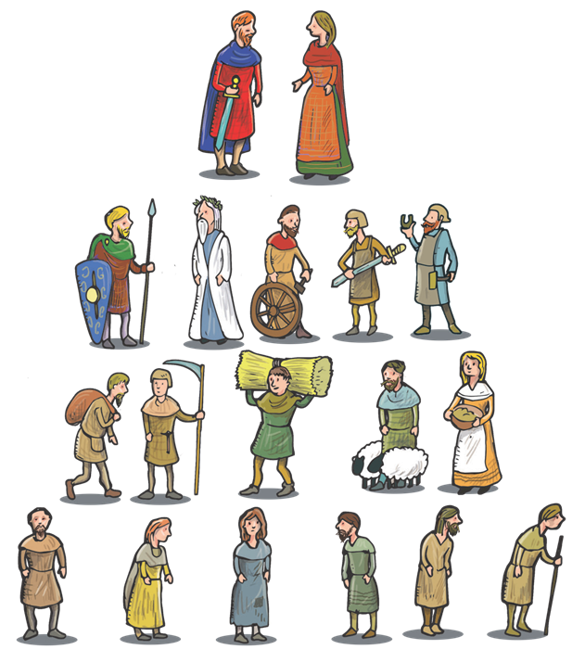

Celtic Society
Ard Rí
(The High King)
King/Queen
Nobles
(Warriors/
Landowners)
Druids
(Priests)
Brehons
(Judges)
Aos Dána
Advisers to the king
Strand Two: The History of Ireland
Chapter Three: Ancient Ireland
Filí
(Poets)
Healers
(Pagan Doctors)
Craftspeople
(metalworkers & masons)
Common People
Farmers
Célsine
Nobles gave protection in return for goods and services
Labourers
Slaves
@MsDoorley

Slide 24
Women in Celtic Society
  Women in the Celtic society were given rights far ahead of their time, very similar to the rights seen in the Norse society (Vikings).
  It was not uncommon for women to achieve an influential status such as becoming Druidesses who were respected throughout Celtic lands or ruling as Queens.
  Celtic women could own property and were represented in the law.
  Women could even become Brigh Brigaid (female judges) and for the most part, any other career path they saw fit.
  The are also many female goddesses prevalent in Celtic mythology.
Strand Two: The History of Ireland
Chapter Three: Ancient Ireland
@MsDoorley

Slide 25
Celtic Art
  The Celts introduced their distinctive artistic flair to Ireland, heralding an era of creativity known for its unique patterns and designs. This specific style, identified as the La Téne style (owing to the discovery of an artefact cache in La Téne, Switzerland), encompassed an array of design elements such as spirals, florals, fantastical creatures, and elegant curves.
  Moreover, the Celts demonstrated remarkable craftsmanship in the creation of elaborate golden jewellery, utilising their design principles to a high degree of detail. As time passed, this artistic style didn't remain stagnant but instead underwent a continuous evolution. The influence of this transformational La Téne style is profound, having left an indelible mark on subsequent generations of Irish art.
Strand Two: The History of Ireland
Chapter Three: Ancient Ireland
@MsDoorley

Slide 26
Celtic Burial Customs and Religion
  Celtic burial practices bore considerable resemblance to those established in the Bronze Age, demonstrating a continuity of customs. Celtic traditions included cremation of the deceased, with the remains subsequently interred in pits or cist graves. These burials were typically accompanied by grave goods, providing an enduring testament to the person's life.
  A distinctive aspect of Celtic burial practices was the use of ogham stones to denote graves. These standing stones, often utilised as boundary markers, showcased the earliest known form of written script in Ireland. The ogham writing system, characterised by horizontal and diagonal etchings along a central vertical line, was a unique addition to the Celtic cultural landscape.
  Prior to the advent of Christianity, druids held the spiritual reins of Celtic society. Their status was only second to the King, reflecting their substantial influence and prominence. Enjoying privileges such as tax exemption and abstention from combat, their societal role was diverse and vital. Druids presided over religious ceremonies, an integral part of the Celtic spiritual life, and held the honour of crowning the King, underlining their pivotal role in maintaining the societal hierarchy.
Strand Two: The History of Ireland
Chapter Three: Ancient Ireland
@MsDoorley

Slide 27
Celtic Burial Customs and Religion
  The Celts, as pagans, worshiped many gods.
Gods | Goddesses
Dagda - King of the Gods, God of Death | Danu - Mother of the Celts, Goddess of Nature
Cú Chulainn - God of Heroes | The Morrigan - Goddess of War, Queen of Demons
Lugh - God of War, Harvest and Sun | Medb, Queen of Connacht - Goddess of Heroes
Cernunnos - God of Nature, Grain, Wealth and Horned Animals | Badb - Goddess of Death, Bringer of the End of the World
Aengus - God of Youth and Love | Brigid - Goddess of Poetry, Prohecy, Healing, Agriculture, and Fire
Strand Two: The History of Ireland
Chapter Three: Ancient Ireland
@MsDoorley

Slide 28
Checkpoint pg. 34 (Artefact, 1st Edition)
  When did the Celts arrive in Ireland?
  How was Celtic society organised?
  Describe (a) a crannóg and (b) a ring-fort.
  What was the La Téne style?
  What did the Celts do with their dead?
  What was ogham? Why is it important?
Strand Two: The History of Ireland
Chapter Three: Ancient Ireland
@MsDoorley

Slide 29
Checkpoint pg. 34 (Artefact, 1st Edition)
  The Celts arrived in Ireland between 500 and 300 BC.
  The rí (king) was at the top of the tuath, with the aos dána (nobles, judges, poets, doctors, skilled craftsmen) and warriors under him, then the peasants, and the slaves at the bottom.
    (a) Crannóg: Human-made islands. Tree trunks were driven down into the bed of a lake and a platform was built on top.
    Ring-fort: Circular enclosures surrounded by a ditch, earth bank and wooden fence. Some also had an underground passage (souterrain).
  La Tène style was an artistic style that originated in Switzerland, featuring spirals, florals, fantasy animals and curved lines.
  The Celts cremated the bodies of their dead and buried them in pits and cist graves, often marked by Ogham stones.
  Ogham was the first written language in Ireland. It is a series of lines and notches along a vertical line to represent letters
Strand Two: The History of Ireland
Chapter Three: Ancient Ireland
@MsDoorley

Slide 30
8,000 BC to AD 400
Chapter 3
3.5: SUMMARY
3.5: Summary
Strand Two: The History of Ireland
@MsDoorley

Slide 31
In this chapter, we have learned that...
  The epochs of the Stone Age (encompassing the Mesolithic and Neolithic periods) and the Bronze Age denote Ireland's prehistoric era - a time devoid of any known written records. The dawn of the Iron Age ushered in the introduction of ogham, marking Ireland's earliest foray into written script.
  During the Mesolithic era, Ireland's inaugural inhabitants arrived, characterised by their hunter-gatherer lifestyle. Their existence was underpinned by the use of stone tools and weapons, a nomadic way of life, and the practice of cremating their deceased.
  The Neolithic period bore witness to a significant shift in lifestyle, with the introduction of farming to Ireland. Now, people began to settle, constructing permanent dwellings, cultivating crops, and rearing livestock. This era also saw the construction of grand tombs, such as passage tombs, portal dolmens, and court cairns, for their deceased, showcasing a shift in burial practices.
  The advent of the Bronze Age brought with it the commonality of metal tools and weaponry in Ireland. People continued to farm and began to dwell in larger residences, bolstered by wooden fortifications for protection. Burial practices evolved further, with graves diminishing in size.
  The Iron Age witnessed the arrival of a new group in Ireland - the Celts. Characterised by their structured society, the Celts came to dominate the cultural and social landscape of Ireland, a domination that persisted until Christianity's arrival on the island.
Strand Two: The History of Ireland
Chapter Three: Ancient Ireland
@MsDoorley

Slide 32
Check Your Learning (pg. 12, Chronicles, 1st Edition)
  Place the following periods into chronological order: Bronze Age, Neolithic Period, Iron Age, Mesolithic Period, Palaeolithic Period.
  How did people cross from Scotland to Ireland in Mesolithic times?
  Relating to the Mesolithic Period, give one piece of information about each of the following: (a) housing, (b) work, (c) burial customs.
  When did farmers first arrive in Ireland?
  Relating to the Neolithic period, give one piece of information about each of the following: (a) housing, (b) work, (c) burial customs.
  Which settlement is older, Mount Sandel in County Derry or the Céide Fields in County Mayo?
  Describe how bronze was made by Smiths in Bronze Age Ireland.
  Relating to the Bronze Age, give one piece of information about each of the following areas: (a) housing, (b) food, (c) weapons and tools.
  Who were the Celts?
  Relating to the Iron Age, give one piece of information about each of the following areas: (a) housing, (b) language and art, (c) weapons and tools.
Strand Two: The History of Ireland
Chapter Three: Ancient Ireland
@MsDoorley

Slide 33
Project
Guidelines:
  Length: The depth of your project should reflect about 2-3 weeks of work.
  Sources: Use at least three different sources for your research. These can be books, scholarly articles, or reputable online resources.
  Citations: All information and images that are not your own should be properly cited.
  Mediums: You may choose to present your project in one of the following ways:
    Poster: Your poster should be informative and visually engaging.
    Minecraft or Lego Model: If choosing this option, please also include a brief report explaining your model.
    Painting/Drawing: Your artwork should be accompanied by a description.
    Recycled Materials: Create your model using recycled materials and provide an explanation of your creative process.
Assessment:
Your projects will be assessed based on:
  Research and Content
  Creativity and Presentation
  Understanding of Context
  Adherence to Guidelines
Strand Two: The History of Ireland
Chapter Three: Ancient Ireland
@MsDoorley

Slide 34
Project
Historical Sites
Historical Figures
Newgrange, County Meath
The Ceide Fields, County Mayo
Mount Sandel, County Londonderry
Poulnabrone Dolmen, County Clare
Lough Gur, County Limerick
Cú Chulainn
Queen Medb (Maeve)
Fionn mac Cumhaill
Deirdre of the Sorrows
Lugh Lamhfada
Cathbad
Mug Ruith
Niall of the Nine Hostages
Tuathal Techtmar
Érimón and Éber Finn
Gobán Saor
Dagda
Aengus
Tuatha Dé Danann
Fir Bolg
Milesians
Strand Two: The History of Ireland
Chapter Three: Ancient Ireland
@MsDoorley

Slide 35
Classwork
Complete the handout given.
Some letters are not part of the the Ogham alphabet. You can use alternatives or drop that missing letter.
Once you have both your first name and surname filled out on the sheet, colour in the Celtic God you have been given.
Make sure your name is written at the top of your sheets.
Strand Two: The History of Ireland
Chapter Three: Ancient Ireland
@MsDoorley

